Slide 1
More on Adder

Slide 2
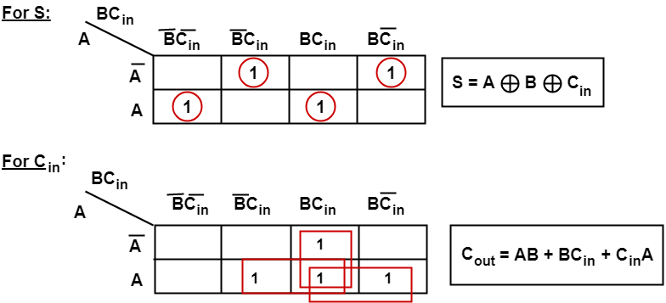
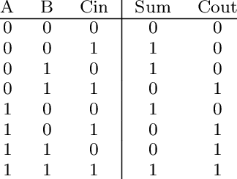
Full adder

Slide 4
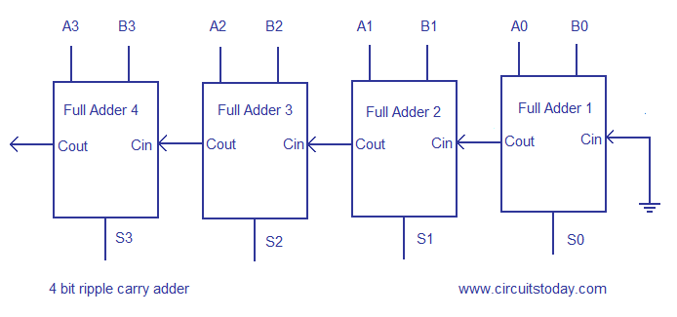
Ripple carry Adder

Slide 5
Carry Look ahead Adder

Slide 7
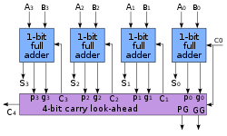
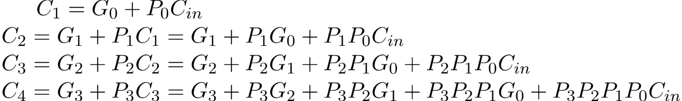
Carry Look ahead Adder

Slide 8
Block Diagram

Slide 9
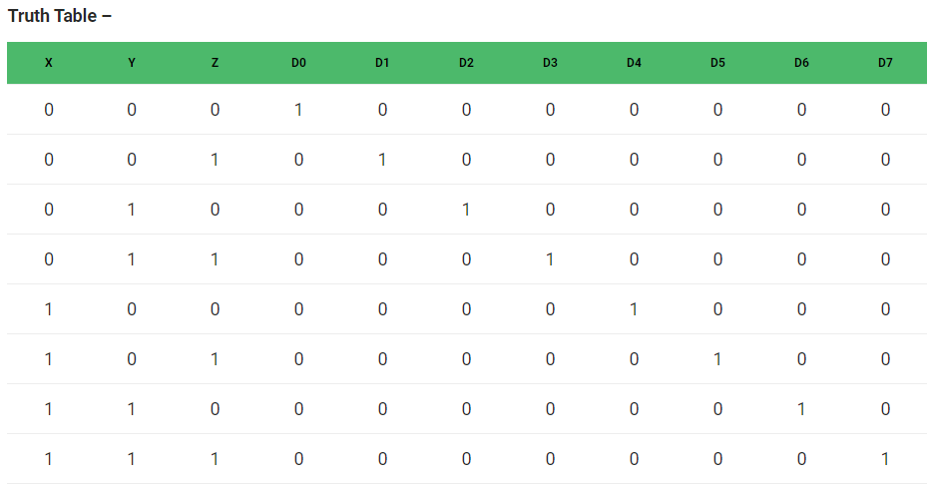
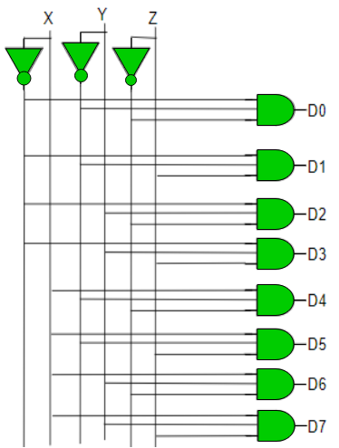
Decoder
D0 = X’ Y’ Z’
D1 = X’ Y’ Z
D2 = X’ Y Z’
D3 = X’ Y Z
D4 = X Y’ Z’
D5 = X Y’ Z
D6 = X Y Z’
D7 = X Y Z

Slide 10
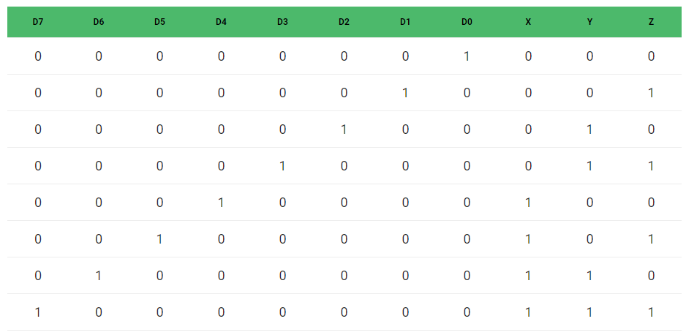
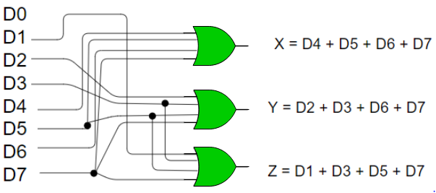
Encoder
X = D4 + D5 + D6 + D7
Y = D2 +D3 + D6 + D7
Z = D1 + D3 + D5 + D7

